Slide 1


Syntax Analyzer
Accredited with Grade A by NAAC
Accredited with Grade A by KCG
Guided By,
Dr. Nikita Bhatt

Slide 2
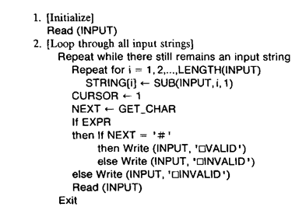
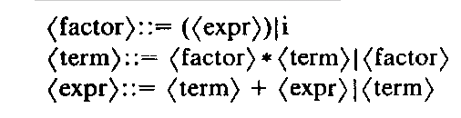
Recursive Descent Parser

Slide 3
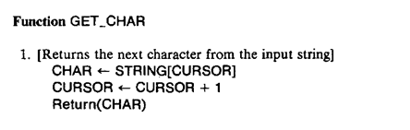
Recursive Descent Parser (Continue)

Slide 4
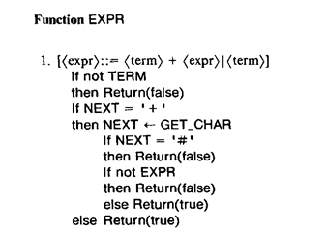
Recursive Descent Parser (Continue)

Slide 5
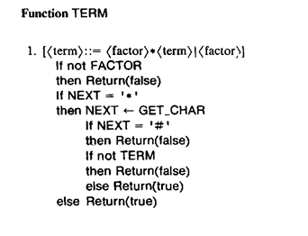
Recursive Descent Parser (Continue)

Slide 6
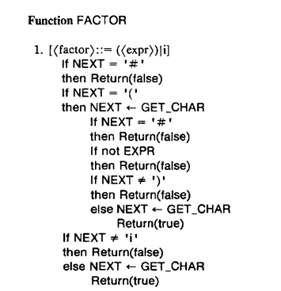
Recursive Descent Parser (Continue)

Slide 7
Thank You

